Slide 1


GITHUB & GIT explained
Aws re/start
By appleseeds
Prepared by: Dr. Antonio Rawad Nassar
feb 2023

Slide 2
WHAT IS GITHUB AND WHAT IS GIT
GitHub is a web-based platform that provides a centralized location for software development projects. It allows developers to store their code, collaborate with others, and manage project versions using the Git version control system. GitHub offers a variety of features including project management tools, issue tracking, and code review.
Git is a free and open-source distributed version control system designed to handle everything from small to very large projects with speed and efficiency. It allows developers to track changes to their code, collaborate with others, and maintain different versions of their project. Git uses a command-line interface, but many graphical user interfaces and third-party tools are available.

Slide 3

WHAT IS DISTRIBUTED VERSION CONTROL SYSTEM
A distributed version control system (DVCS) is a type of version control system that allows multiple developers to collaborate on the same codebase without the need for a centralized repository. In a DVCS, each developer maintains a complete copy of the project's source code and its history on their local machine.
This is in contrast to centralized version control systems (CVCS) like Subversion, where a single centralized repository is used to store the project's source code and history, and developers must connect to this repository to access the code and make changes.

Slide 4
FEUTURE AND FUNCTIONALITY OF GIT /GITHUB

Slide 5

Git:
Distributed version control system
Fast and efficient performance
Ability to handle both small and large projects
Powerful branching and merging capabilities
Supports both command-line and graphical user interfaces
Lightweight and easy to install
Offers support for offline work
Allows developers to create local repositories on their machines

Slide 6

GitHub:
Web-based platform for managing Git repositories.
Provides a centralized location for software development projects
Offers tools for project management, issue tracking, and code review
Allows developers to collaborate on code and track changes made by others
Provides a social network for developers to connect and share code
Offers integration with other tools and services, such as CI/CD tools and third-party plugins
Provides a secure and reliable hosting platform for code repositories
Offers a range of pricing options, including free and paid plans

Slide 7
ALTERNATIVES OF GITHUB
While GitHub is a popular choice for managing code repositories, there are several alternative platforms available that offer similar functionality. Some of the most popular alternatives to GitHub are:
GitLab: GitLab is a web-based Git repository manager that provides similar features to GitHub, including issue tracking, code review, and continuous integration and deployment. It also offers additional features such as integrated project management and wiki functionality.
Bitbucket: Bitbucket is a Git-based hosting service that is similar to GitHub, offering features such as code reviews, issue tracking, and pull requests. It is owned by Atlassian, the same company behind popular tools such as Jira and Confluence.
SourceForge: SourceForge is a web-based platform that provides a range of tools for managing software development projects, including Git-based version control, issue tracking, and project management tools.
Launchpad: Launchpad is a web-based platform that provides version control, bug tracking, and project management tools for software development projects. It also provides a build system for building and distributing packages.
GitKraken: GitKraken is a Git client that provides a graphical user interface for managing Git repositories. It supports both GitHub and other Git hosting platforms.
These alternatives offer similar functionality to GitHub, but may have differences in terms of pricing, features, and user experience. Ultimately, the choice of platform will depend on the specific needs and requirements of the development team.

Slide 8
WHY WE STUDY
here are some reasons why we study Git:
Version control: Git is a powerful version control system that allows developers to track changes to their code over time. By using Git, developers can easily revert to previous versions of code, compare changes between versions, and collaborate with others on code changes.
Collaboration: Git provides powerful tools for collaborating with other developers on code changes. Developers can use Git to create and manage branches, merge changes from multiple contributors, and review code changes before they are merged into the main codebase.
Efficiency: Git can help developers work more efficiently by automating tasks such as merging code changes and resolving conflicts. This can save developers time and reduce the risk of errors in the codebase.
Portability: Git is a portable system that can be used on a wide range of platforms, including Windows, macOS, and Linux. This makes it easy for developers to work on code from any computer or location.
Open source community: Git is an open source system that is supported by a large and active community of developers. This community provides resources, tools, and support for Git users, making it easier to learn and use Git effectively.
Industry standard: Git is widely used in the software development industry and is a standard tool for managing code repositories. Learning Git can help developers to be more competitive in the job market and to work more effectively in a professional environment.
Overall, studying Git can help developers to become more efficient, collaborative, and effective in managing code repositories. It is an essential tool for modern software development and is used by millions of developers worldwide

Slide 9
GET STARTED WITH GITHUB,
Here's a step-by-step guide to getting started with GitHub:
Go to the GitHub website at https://github.com/.
Click on the "Sign up" button in the top right corner of the page.
Enter your preferred username, email address, and a strong password. You can also sign up using your Google account or Apple ID.
Select your plan. GitHub offers free and paid plans with different features and storage limits. For most users, the free plan should be sufficient.
Complete the short questionnaire that asks you about your experience with coding and your intended use of GitHub.
Verify your email address. GitHub will send you an email with a verification link that you need to click on to complete your registration.
Customize your profile. You can add a profile picture, bio, and other information to your GitHub profile to help other users get to know you.
Explore the GitHub interface. Once you're logged in, you can browse existing repositories, search for projects, and create your own repositories.
That's it! With these steps, you should now have a GitHub account and be ready to start using Git and GitHub for version control and collaboration on software development projects.

Slide 11
HOW TO CREATE TEAM IN GITHUB
To create a team in GitHub, follow these steps:
Navigate to your organization's page in GitHub.
Click on the "Teams" tab.
Click the green "New team" button.
Enter a team name, description, and select the level of permissions for the team.
Choose the repositories or projects the team will have access to.
Add members to the team by typing in their GitHub usernames.
Click the "Create team" button.
Once the team is created, you can manage its settings, permissions, and members from the team page in GitHub.

Slide 12
GET STARTED WITH GIT
here are the steps to download and get started with Git:
Go to the Git website at https://git-scm.com/downloads.
Choose the version of Git that is compatible with your operating system. Git is available for Windows, Mac, and Linux.
Click on the download link to begin the download.
Once the download is complete, open the installation file and follow the prompts to install Git on your local machine. You can choose the default settings or customize the installation based on your preferences.
After installation, open your command prompt or terminal window and type "git --version" to verify that Git is installed correctly. This should display the version of Git that you have installed.

Slide 13
Set up your Git username and email address.
Open your terminal or Git client and run the following commands, replacing "your username" and "your email address" with your actual username and email address:
git config --global user.name "your username"
git config --global user.email "your email address"
Now you're ready to start using Git! You can create a new repository, clone an existing repository, make changes, commit them, and push them to GitHub or another Git hosting service.

Slide 14
Git terminology and language used in the industry:
1 OF 2
Repository: A repository is a storage location for code that is managed using Git.
Commit: A commit is a snapshot of changes made to the codebase at a particular point in time.
Branch: A branch is a separate line of development in a codebase that is managed using Git. Branches allow developers to work on different features or changes in isolation from each other.
Merge: Merging is the process of combining changes from one branch of a codebase into another.
Pull request: A pull request is a request to merge changes from one branch of a codebase into another. Pull requests are commonly used for code reviews and collaboration between developers.

Slide 15
TEMINOLOGY &LANGUAGE
2OF2
Clone: Cloning is the process of creating a copy of a Git repository on a local machine.
Fork: Forking is the process of creating a copy of a Git repository on a remote server or code hosting platform such as GitHub or GitLab. Forking allows developers to create their own copy of a codebase and make changes to it without affecting the original codebase.
Push: Pushing is the process of uploading local changes to a remote repository.
Pull: Pulling is the process of downloading changes from a remote repository to a local machine.
Conflict: A conflict occurs when two or more changes to the same file or line of code cannot be automatically merged by Git. Conflicts must be resolved manually by the developer.
These terms and concepts are important to understand when using Git, as they are commonly used in the industry and in Git documentation and tutorials.

Slide 16
Repository:
Definition
In Git, a repository is a data structure used to store and manage a collection of files, directories, and other related data. A repository can be thought of as a centralized location where a project's source code and related files are stored, managed, and versioned over time.
When you create a Git repository, it creates a hidden directory named ".git" in the root directory of the project. This directory contains all of the metadata and version control information that Git uses to manage the repository, such as the commit history, branches, and configuration settings.
Repositories can be either local or remote.
Local repositories are stored on your local machine.
remote repositories are hosted on a remote server or code hosting platform such as GitHub, GitLab, or Bitbucket.
By using a Git repository, developers can track changes to their code over time, collaborate with others on code changes, and manage multiple versions of a project's codebase. This makes it easier to maintain high-quality code, work efficiently in a team environment, and manage complex software projects.

Slide 17
Branch:
In Git, a branch is a separate line of development that allows developers to work on different features or changes in isolation from each other. A branch is essentially a snapshot of a project's codebase at a particular point in time.
When you create a branch in Git, you create a separate copy of the codebase that you can modify independently of the main branch, also known as the "master" branch. This allows you to work on a new feature or fix a bug without affecting the main codebase until you are ready to merge your changes back into the master branch.
Branches can be created and managed using Git commands or through the use of a Git hosting platform such as GitHub or GitLab. When you create a branch, Git creates a pointer to a specific commit in the repository's history. As you make changes to the branch, Git updates the pointer to track your changes.
Branches can be merged back into the master branch using the Git merge command. This combines the changes made on the branch with the changes on the master branch. If there are conflicts between the two branches, Git will prompt you to resolve the conflicts before the merge can be completed.

Slide 18
Commit:
In Git, a commit is a snapshot of the changes made to a codebase at a particular point in time. When you commit changes to a Git repository, you are creating a record of the modifications made to the files and directories in the repository.
Each commit is identified by a unique hash value that is based on the contents of the commit and its metadata, such as the commit message, author, and timestamp. Commits are arranged in a linear sequence, with each commit pointing to its parent commit.
When you make changes to the codebase, Git uses a staging area to track those changes. You can selectively stage changes to specific files or directories using Git commands, and then commit the staged changes to create a new commit.
By using commits in Git, developers can track changes to a codebase over time, collaborate with others on code changes, and manage multiple versions of a project's codebase. This makes it easier to maintain high-quality code, work efficiently in a team environment, and manage complex software projects.

Slide 19
Git init command
The git init command is used to initialize a new Git repository. This command creates a new .git subdirectory in the current working directory, which will be used to store all of the version control data for the project.
You would typically use git init when starting a new project that you want to track using Git version control. It is used at the very beginning of the project, before you have made any commits or pushed anything to a remote repository.
Here is an example of how to use git init:
Open a terminal window and navigate to the directory where you want to initialize the repository.
Run the command git init. This will create a new .git directory in the current working directory.
$ git init Initialized empty Git repository in /Users/username/project/.git/
Once the repository has been initialized, you can start adding files to it and making commits using the git add and git commit commands.
Note that git init should only be used once per repository. Once the repository has been initialized, you can use other Git commands to manage the repository, such as git add, git commit, git push, and git pull.

Slide 20
Merge:
In Git, merging is the process of combining changes from one branch into another. Merging is typically used to incorporate changes made on a feature branch into the main branch of a repository, such as the master branch.
When you merge two branches in Git, Git takes the changes made on the two branches and combines them into a new commit. This creates a new snapshot of the codebase that includes the changes from both branches.
Merging can be done either using Git commands or through the use of a Git hosting platform such as GitHub or GitLab.
When you merge a branch, Git checks the history of both branches to identify the common ancestor commit from which the two branches diverged. It then uses this common ancestor as a starting point for the merge.
If there are no conflicts between the changes made on the two branches, Git will automatically merge the changes and create a new commit. However, if there are conflicting changes made on the two branches, Git will prompt you to resolve the conflicts manually before the merge can be completed.
By using merging in Git, developers can incorporate changes made on different branches into a single codebase, which makes it easier to manage changes and track the development of a project over time. Merging is an important aspect of modern software development, as it enables developers to work on different features or fixes simultaneously without interfering with each other's work.

Slide 21
Push/Pull Requests
Push and pull are two basic Git commands that are used to interact with remote repositories.
Push is a command that is used to upload changes made to a local Git repository to a remote repository. When you push changes to a remote repository, Git uploads the new commits and updates the remote repository's history to include the new changes.
Pull, on the other hand, is a command that is used to download changes made to a remote repository and merge them into a local repository.
When you pull changes from a remote repository, Git downloads the new commits and merges them into the current branch of your local repository.
The pull request process typically involves a code review, in which other developers review the changes and provide feedback. Once the changes have been reviewed and approved, the pull request can be merged into the target branch using the Git merge command.
In summary, push is used to upload changes from a local repository to a remote repository, pull is used to download changes from a remote repository to a local repository, and a pull request is a request to merge changes made on a branch into another branch.

Slide 22
Clone:/Fork/Conflict/
Clone, fork, and conflict are terms used in Git that are related to collaborating with others on a shared codebase.
Clone is the process of creating a local copy of a remote Git repository. When you clone a repository, Git downloads the entire repository's codebase and version history onto your local machine. This enables you to work on the code locally and make changes that can be pushed back to the remote repository.
Fork is a feature of Git hosting platforms such as GitHub that allows you to create a personal copy of a repository. When you fork a repository, you create a copy of the codebase in your own account, which you can modify independently of the original repository. You can then push changes to your forked repository and create a pull request to merge those changes into the original repository.
Conflict is a situation that arises when two or more people make changes to the same file or codebase at the same time. When there is a conflict, Git cannot automatically merge the changes, and you must manually resolve the conflict. This involves reviewing the changes made by each person and deciding how to combine them in a way that makes sense. Git provides tools to help you resolve conflicts, such as merging changes or choosing one version of the code over another.

Slide 23
HOW TO CREATE REPO AND FILES IN GITHUB
Here are the steps to create a new repository and add files to it on GitHub:
Log in to your GitHub account and click on the "+" button in the top-right corner of the page.
Click on "New repository" in the dropdown menu.
Enter a name for your repository and choose whether it should be public or private. You can also add a description and choose whether to initialize the repository with a README file.
Click on the "Create repository" button.
On the next page, you can add files to your repository. You can either
create a new file by clicking on the "Create new file" button or
upload an existing file by clicking on the "Upload files" button.
To create a new file, enter a name for the file and add some content to it using the editor. You can also choose the file format from the dropdown menu.
Once you've added your file content, click on the "Commit new file" button to save your changes.
To upload an existing file, drag and drop the file onto the upload area or click on the upload area to browse for the file on your computer.
Once you've uploaded your file, enter a commit message to describe the changes you've made.
Click on the "Commit changes" button to save your changes to the repository.
That's it! Your new repository is now created with files added to it.

Slide 24
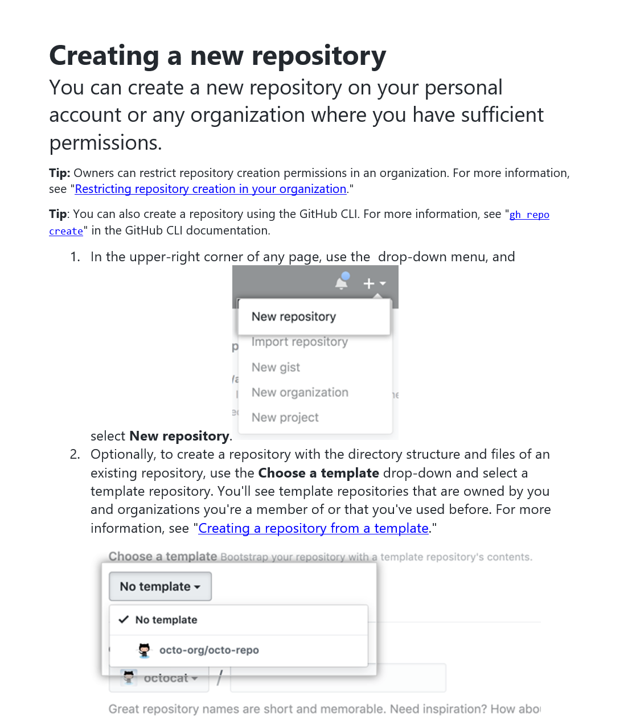
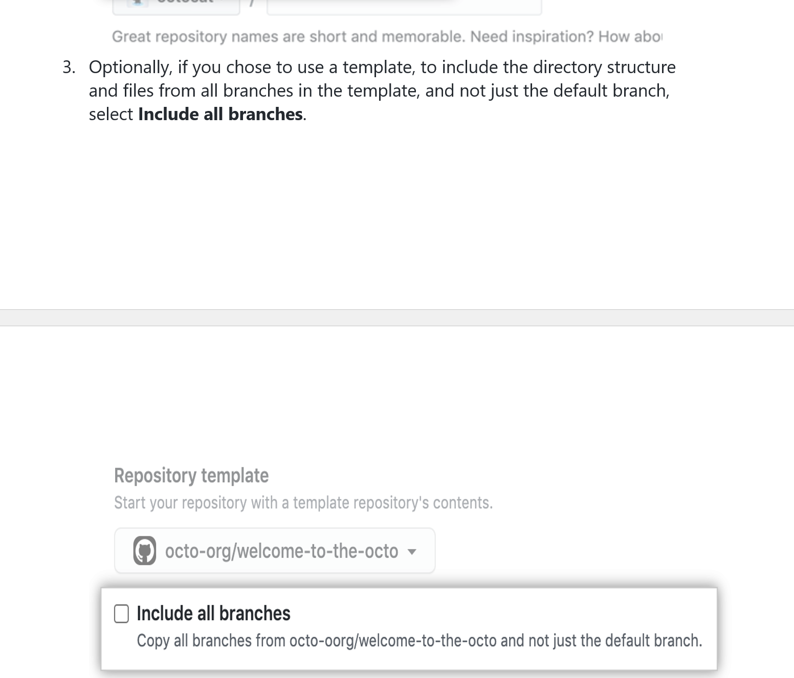
TO CREATE REPO

Slide 25
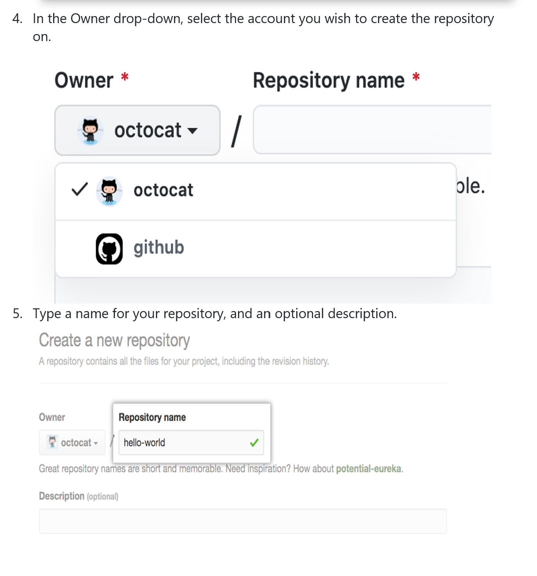
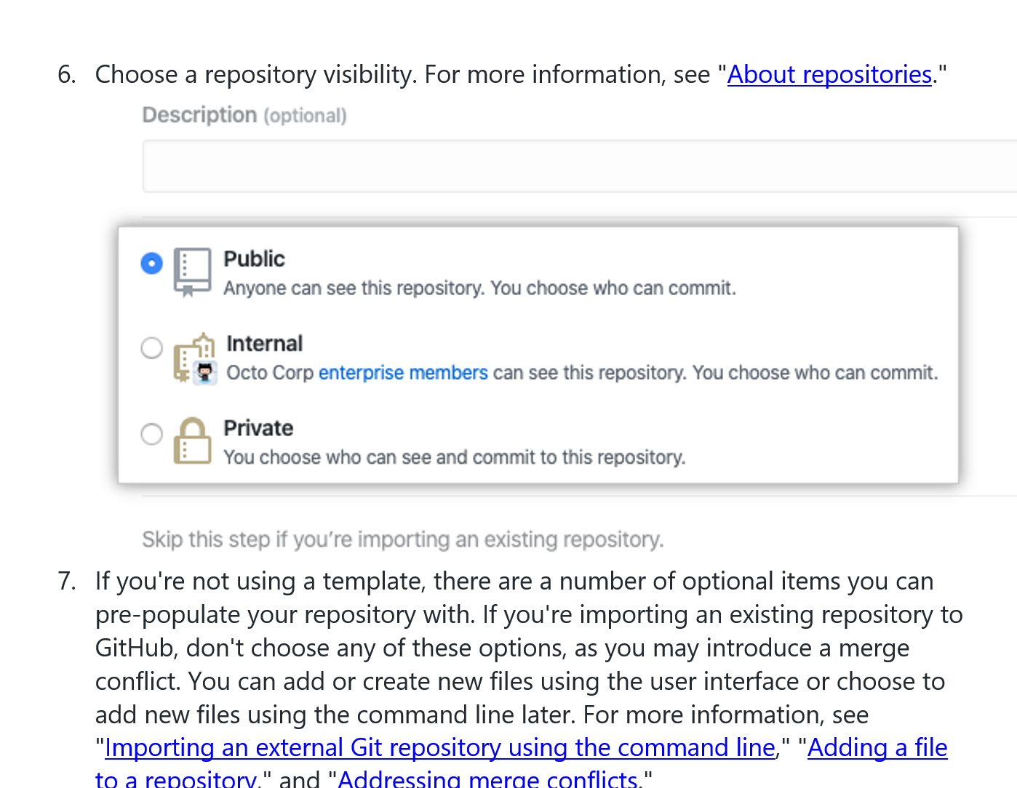
TO CREATE REPO

Slide 26
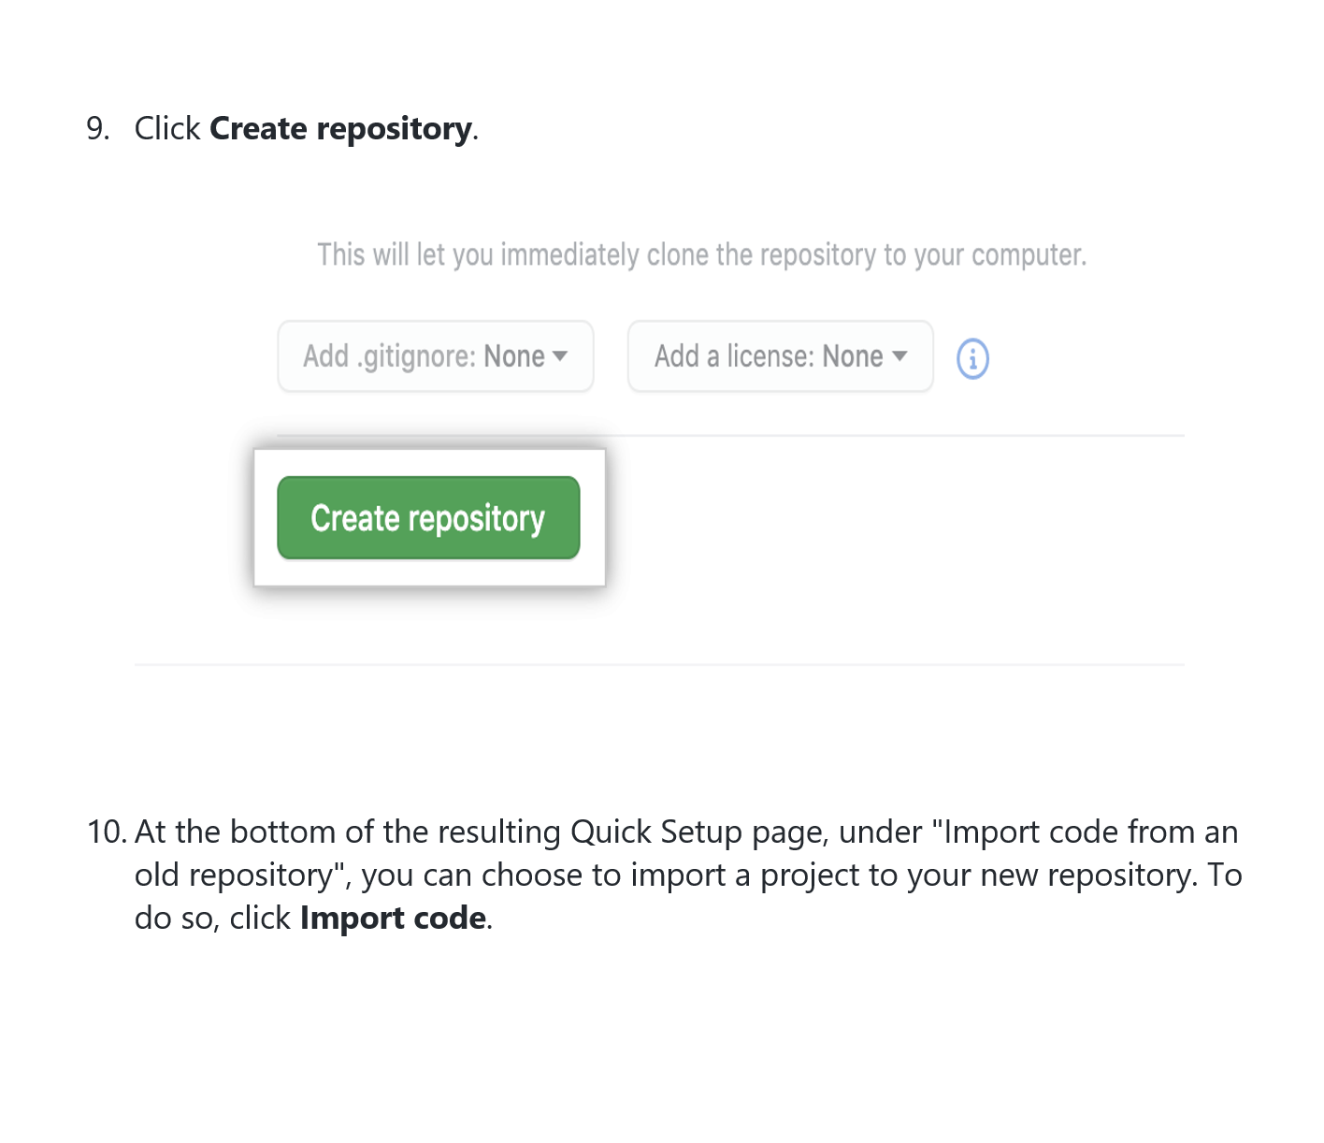
TO CREATE REPO

Slide 27
how to DELETE repo from get hub
To delete a repository from GitHub, you can follow these steps:
1. Go to the repository page on GitHub that you want to delete.
2. Click on the "Settings" button in the top-right corner of the page.
3. Scroll down to the "Danger Zone" section at the bottom of the page.
4. Click on the "Delete this repository" button.
5. Enter the name of the repository that you want to delete to confirm the deletion.
6. Click on the "I understand the consequences, delete this repository" button.
7. The repository will now be deleted from GitHub.
Please note that deleting a repository is permanent and cannot be undone. If you have important code or files in the repository, make sure to download a copy of them before deleting the repository.

Slide 28
README.md
Note
• When you create a new repository on GitHub, you have the option to initialize it with a README file. If you choose to do so, GitHub will automatically create a file called README.md in the root directory of your repository.
The README.md file is a text file that contains information about your project. It's often used to provide an overview of the project, including its purpose, how to install and use it, and any other important details.
The .md file extension stands for "Markdown". Markdown is a lightweight markup language that allows you to format text using simple syntax. Markdown is commonly used on GitHub to format text in README files, issue descriptions, comments, and other places where text is displayed.
Markdown allows you to create headings, lists, links, images, and other formatting elements using simple syntax. For example, you can create a heading by starting a line with one or more hash (#) symbols, like this:
# My Project
This will create a top-level heading in your README.md file that says "My Project".
By default, GitHub will display the contents of the README.md file on the front page of your repository, so it's a good idea to use this file to provide a clear and concise overview of your project.

Slide 29
WHAT ARE REPO TAMPLETS AND HOW WE CAN PERSONALIZE
GitHub repository templates are a way to create a new repository with a pre-existing directory structure, including files and folders. These templates are often used to set up a common structure for projects that have multiple contributors or to standardize the structure of a project within an organization.
When creating a new repository on GitHub, you can choose to use a repository template instead of starting from scratch. You can either use one of the built-in templates provided by GitHub, or you can create your own template by setting up a repository with the directory structure you want and marking it as a template.
To personalize a repository template, you can customize the files and directories in the template to suit your needs. For example, you might add or remove files, modify existing files, or rearrange the directory structure. Once you have made your changes, you can save the repository as a template by marking it as a template repository in the repository settings.

Slide 30
Clone
GITINIT
here are the steps to clone a repository and get started with Git:
First, navigate to the repository you want to clone on GitHub.
Click the "Code" button and copy the URL for the repository.
Open your terminal or command prompt on your local machine.
Use the cd command to navigate to the directory where you want to clone the repository.
Type git clone followed by the URL you copied earlier. For example:
git clone https://github.com/username/repository.git
Press enter to execute the command. Git will create a new directory with the same name as the repository in the directory you're currently in, and clone the repository into that directory.
Once the repository is cloned, navigate into the directory using the cd command.
You can now start making changes to the code and files in the repository on your local machine.
When you're ready to save your changes, use the git add command to add your changes to the staging area.
Use the git commit command to create a new commit with your changes and a commit message describing the changes you made.
Finally, use the git push command to push your changes to the remote repository on GitHub.

Slide 31
clone a repository using Git:
Open your terminal or command prompt on your local machine.
Use the cd command to navigate to the directory where you want to create the new directory. For example:
cd Documents
This will navigate to the "Documents" directory. Replace "Documents" with the name of the directory you want to navigate to.
Use the mkdir command to create a new directory. For example:
mkdir my-project
This will create a new directory named "my-project" in the current directory.
Use the cd command to navigate into the new directory. For example:
cd my-project
This will navigate into the "my-project" directory.
Use the git clone comm and to clone the repository. For example:
git clone https://github.com/username/repository.git

Slide 32
clone a repository using Git:
Replace "username" with the username of the owner of the repository, and "repository" with the name of the repository you want to clone.
Press enter to execute the command. Git will create a new directory with the same name as the repository in the "my-project" directory, and clone the repository into that directory.
Cloning into 'repository'... remote: Enumerating objects: 34, done. remote: Counting objects: 100% (34/34), done. remote: Compressing objects: 100% (22/22), done. remote: Total 34 (delta 10), reused 30 (delta 6), pack-reused 0 Unpacking objects: 100% (34/34), done.
Once the repository is cloned, navigate into the directory using the cd command. For example:
cd repository
This will navigate into the cloned repository directory.
You can now start making changes to the code and files in the repository on your local machine

Slide 33
Add And Reset And Commit & Explain Progress
In Git, adding, resetting, and committing changes are key steps in managing the version control of your project. Here is an overview of each of these steps:
Adding changes: When you make changes to your project files, Git does not automatically track them. You need to add the changes to the staging area to prepare them for committing. This can be done with the git add command, which adds the changes to the staging area.
Example: git add file.txt will add the changes made to file.txt to the staging area.
Resetting changes: If you have added changes to the staging area but decide you want to undo them, you can use the git reset command to remove them from the staging area.
Example: git reset file.txt will remove the changes made to file.txt from the staging area.

Slide 34
Add And Reset And Commit & Explain Progress
…..
Committing changes: Once you have added the changes to the staging area, you can commit them to the repository with a message that describes the changes you have made. This can be done with the git commit command.
Example: git commit -m "Added new feature to file.txt" will commit the
Progress in Git refers to the series of changes made to a project over time. Each commit represents a snapshot of the project at a particular point in time, and the sequence of commits shows the progress of the project. By using Git to manage your project, you can track changes, collaborate with others, and revert to previous versions of your project if needed.

Slide 35
example sequence of commands you might use to add, reset, and commit changes in Git:
Create a new file in your local repository, such as example.txt.
$ touch example.txt
Add the file to the staging area.
$ git add example.txt
Check the status of your changes.
$ git status
Output:
On branch main Changes to be committed: (use "git restore --staged <file>..." to unstage) new file: example.txt
Make changes to the file, such as adding some text to it.
$ nano example.txt
Reset the changes you made to the file.
$ git reset example.txt

Slide 36
ADD RESET,COMMIT
Check the status of your changes again.
$ git status
Output:
On branch main Changes not staged for commit: (use "git add <file>..." to update what will be committed) (use "git restore <file>..." to discard changes in working directory) modified: example.txt no changes added to commit (use "git add" and/or "git commit -a")
Add the changes to the staging area again.
$ git add example.txt
Commit the changes to your local repository.
$ git commit -m "Add some text to example.txt"
Check the status of your changes one last time.
$ git status
Output:
On branch main nothing to commit, working tree clean

Slide 37
In summery
git add is a command used to add changes made to files in the working directory to the staging area. The staging area is an intermediate step before committing changes to the repository. When a file is added to the staging area, it is prepared to be committed to the repository
git status is a command that shows the status of the working directory and the staging area. It shows which files have been modified and which changes have been staged for the next commit.
There are several ways to use git add:
git add <file>: Adds a specific file to the staging area.
git add . or git add --all: Adds all changes in the working directory to the staging area.
git add -p: Interactively adds changes to the staging area, allowing the user to select which changes to include.
It's important to note that changes that have not been added to the staging area will not be included in the next commit. Therefore, it's important to use git add to stage changes before committing them.

Slide 38
HOW TO UNSTAGE UNWANTED FILE
If you have added a file to the staging area using the git add command, but then decide that you don't want to include it in your commit, you can unstage the file using the git reset command.
Here are the steps to unstage a file:
Run git status to see which files are staged for commit.
Identify the file you want to unstage.
Run git reset HEAD <file> to unstage the file. Replace <file> with the name of the file you want to unstage.
Run git status again to confirm that the file has been unstaged.
Note that git reset does not delete the file from your working directory, it only removes it from the staging area.

Slide 39
lets make example
we do get add to 3 files antonio, index and Appleseed
Start by navigating to the local repository on your terminal using the cd command.
Check the status of your repository using the git status command to see which files are modified or untracked.
To stage the changes you want to commit, use the git add command followed by the names of the files you want to stage.
For example, git add antonio index Appleseed.
If you accidentally staged a file you didn't want to commit, you can unstage it using the git reset command followed by the name of the file.
For example, git reset antonio.
After unstaging the file, you can verify that it is no longer staged by using the git status command again.
“The file should now be listed as "Changes not staged for commit".
That's it! You can now continue with the git commit command to commit the changes you want to your repository.

Slide 40
PUSH LOCAL CHANGES TO REMOTE REPOSITORY
Here are the steps to push local changes to a remote repository:
Pushing local changes to a remote repository involves sending the committed changes from your local repository to the corresponding remote repository. The process is typically done using the Git command git push.
First, make sure that you are in the local repository directory using the command cd <directory>.
Check the status of your local repository using the command git status. This command will show you the current state of your local repository.
If there are changes to commit, stage the changes using the command git add <file> to add a specific file or git add . to add all the files.
Commit the changes using the command git commit -m "<commit message>".
Once the changes are committed, use the command git push <remote> <branch> to push the changes to the remote repository. For example, git push origin main.
Enter your GitHub credentials when prompted.
After the push is successful, you can verify that the changes have been pushed by going to the remote repository on GitHub and checking the corresponding branch.

Slide 41
WHAT IS THE “MASTER” AND THE “ORIGIN”
In Git, "master" is the default name for the main branch of a repository. This is the branch that typically represents the most stable and up-to-date version of the code.
"Origin" refers to the default remote repository that your local repository is synced with.
So, in summary, "master" refers to the default branch in a local repository, while "origin" refers to the default remote repository that the local repository is synced with.

Slide 42
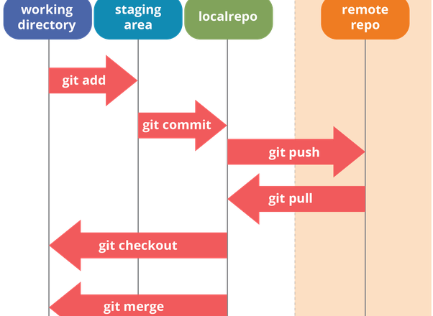
MASTER ORIGIN REPO DIAGRAM
When you first clone a repository, Git sets up a relationship between your local master branch and the remote origin repository. This means that when you push changes to origin, Git will update the code in the remote repository. Likewise, when you pull changes from origin, Git will update your local master branch with the latest version of the code.
In this diagram, you can see that the local master branch is separate from the remote origin repository. When you make changes to the code on your local master branch and want to share those changes with others, you push the changes to the origin repository. When others make changes to the code in the origin repository and you want to get those changes, you pull them down to your local master branch.

Slide 43
Git Branch / Get Remote -v,
git branch is a command used to manage branches in a Git repository. It allows you to list, create, delete, and switch between branches.
Here are some commonly used git branch commands:
git branch: Lists all branches in the repository.
git branch <branch_name>: Creates a new branch with the specified name.
git branch -d <branch_name>: Deletes the specified branch.
git checkout <branch_name>: Switches to the specified branch.
git remote -v is a command used to list all the remote repositories associated with your local repository. It shows the URL of the remote repository and its name (typically "origin").

Slide 44
Here's an example of how to use git branch and git remote -v:
Open your terminal and navigate to your local Git repository.
Use the git branch command to list all branches in the repository. You should see something like this:
master * my-feature-branch
The asterisk indicates that you are currently on the my-feature-branch branch.
Use the git branch <branch_name> command to create a new branch. For example, git branch my-new-branch would create a new branch called my-new-branch.
Use the git checkout <branch_name> command to switch to the new branch. For example, git checkout my-new-branch would switch to the my-new-branch branch.
Use the git remote -v command to list all the remote repositories associated with your local repository. You should see something like this:
origin https://github.com/your-username/your-repository.git (fetch) origin https://github.com/your-username/your-repository.git (push)
This shows that the remote repository is named origin and has the URL https://github.com/your-username/your-repository.git.
These commands are commonly used when collaborating on a project with others or when working on multiple branches or repositories.

Slide 45
Pull Changes From Remote Repository
To pull changes from a remote repository in Git, you can use the following command:
git pull
This command fetches any new changes from the remote repository and merges them into your current branch.
Alternatively, you can also use the following commands:
git fetch git merge <remote>/<branch>
The git fetch command fetches the latest changes from the remote repository, but it doesn't merge them into your current branch. Instead, it updates your local copy of the remote branch.
After running git fetch, you can merge the remote changes into your current branch using the git merge command. Replace <remote> with the name of the remote repository (e.g., origin) and <branch> with the name of the remote branch you want to merge.

Slide 46
Everything About Git Configurations
Git configurations are settings that determine how Git behaves on a particular system
Here are some common Git configurations and how to set them:
User name and email: These configurations are used to identify the author of the commits. To set these configurations globally, run the following commands:
git config --global user.name "Your Name"
git config --global user.email "youremail@example.com"
Default editor: Git uses the default editor to open the commit message when creating a new commit. To set the default editor to Vim, run the following command:
git config --global core.editor "vim"
Line ending conversion: Different operating systems use different line endings in text files. Git can convert line endings to a specific format when committing and checking out files. To set the line ending conversion to the Unix format, run the following command:
git config --global core.autocrlf input

Slide 47
Config….
Aliases: Git allows you to create aliases for commonly used commands. For example, you can create an alias for git status to git s. To create an alias, run the following command:
git config --global alias.s status
These are just a few examples of Git configurations. There are many other configurations available, such as color output, merge strategies, and more. You can view your current Git configurations by running the following command:
git config --list

Slide 48
Generate And Test Github Public Key
Generating and testing a public key for GitHub is an important step to securely connect to GitHub from your local machine. Here are the steps to generate and test a public key:
Open the terminal on your local machine and run the following command to generate a new public/private key pair:
ssh-keygen -t ed25519 -C "your_email@example.com"
This command generates a new public/private key pair using the ed25519 algorithm and associates it with your email address. You can use a different algorithm if you prefer, such as RSA.
When prompted, choose a secure location to save the key pair. By default, the key pair is saved in the ~/.ssh directory with the names id_ed25519 and id_ed25519.pub.

Slide 49
Generate And Test Github Public Key
Once the key pair is generated, you need to add the public key to your GitHub account. Open your GitHub account settings, navigate to the "SSH and GPG keys" tab, and click on "New SSH key".
Give a descriptive title to the key, such as "My Laptop SSH Key".
Copy the contents of the public key file (id_ed25519.pub) into the "Key" field in the GitHub SSH key settings.
Save the new SSH key.
Test the key by running the following command in your terminal:
ssh -T git@github.com
This command tests the SSH connection to GitHub and should return a message that says "Hi <your_username>! You've successfully authenticated, but GitHub does not provide shell access."
Congratulations, you have now generated and tested a public key for GitHub!

Slide 50
Create Repository From Existing Project
To create a repository from an existing project, you can use the following steps:
Create a new repository on GitHub: Go to GitHub and create a new repository by clicking on the "+" button in the top-right corner of the page and selecting "New repository" from the drop-down menu.
Give your repository a name: Give your repository a name that is relevant to your project.
Add a description: Add a brief description of your project.
Choose the repository type: You can choose between a public or private repository depending on your needs.
Initialize the repository: Check the option to "Initialize this repository with a README" if you want to create a README file for your project.

Slide 51
Create the repository: Click on the "Create repository" button to create your new repository.
Clone the repository: Copy the URL of your new repository and use the Git command line tool to clone the repository onto your local machine using the git clone command.
Add your files: Copy your project files into the cloned repository on your local machine.
Stage and commit your changes: Use the git add command to stage your changes, and then use the git commit command to commit your changes to the repository.
Push your changes to GitHub: Use the git push command to push your changes to GitHub.
That's it! Your existing project is now in a new repository on GitHub.

Slide 52
A pull request (PR)
is a way to propose changes to a repository hosted on GitHub. It allows contributors to notify others about changes they've made and request that someone else review and merge those changes into the repository.
Let's say you found a typo in the documentation of a repository on GitHub, and you want to contribute by fixing it. Here are the steps you would typically follow to create a pull request:
Fork the repository: Click the "Fork" button in the top right corner of the repository's page on GitHub. This will create a copy of the repository under your account.
Clone the forked repository: On your local machine, use the git clone command to create a local copy of the forked repository. For example:
git clone https://github.com/your-username/repository-name.git
Create a new branch: Use the git checkout command to create a new branch for your changes. For example:
git checkout -b fix-typo
This creates a new branch called "fix-typo" and switches to it. You can now make your changes to the code or documentation.
Commit your changes: Use the git add command to stage your changes, and the git commit command to create a new commit with a message describing your changes. For example:
git add documentation.md git commit -m "Fix typo in documentation"

Slide 53
……..>
Push your changes to GitHub: Use the git push command to push your changes to the forked repository on GitHub. For example:
git push origin fix-typo
Create a pull request: Go to the repository's page on GitHub and click the "New pull request" button. Select the branch you just pushed, and compare it to the original repository's master branch. GitHub will show you a preview of the changes you made. Give your pull request a title and description explaining your changes, and click "Create pull request".
Wait for feedback and merge: The maintainers of the original repository can now review your changes, ask for more information, or suggest modifications. Once they are satisfied with the changes, they can merge your pull request into the master branch of the original repository.
That's the basic workflow for creating a pull request on GitHub. It allows developers to collaborate on projects more easily and transparently.

Slide 54
Learn About Branching And Merging
Branching and merging are important concepts in Git that allow developers to work on different versions of the same codebase and combine their changes seamlessly.
A branch is a separate line of development in Git. When you create a new branch, you are essentially creating a new version of your project that can be modified independently of the original version. Each branch has its own set of changes and history.
Merging is the process of combining the changes made in one branch into another branch. When you merge two branches, you are essentially combining the changes made in one branch into another branch, thereby creating a new version of the codebase that includes the changes from both branches.

Slide 55
Here are some common Git commands used for branching and merging:
git branch: This command is used to list, create, or delete branches.
git checkout: This command is used to switch between branches.
git merge: This command is used to merge changes from one branch into another.
git rebase: This command is used to apply changes from one branch on top of another branch.
git cherry-pick: This command is used to apply a specific commit from one branch onto another branch.

Slide 56
Git Branch -d /Git Branch -D
The git branch -d command is used to delete a branch in Git. It stands for "delete" and is used to delete the specified branch if it has already been merged into the current branch.
The git branch -D command, on the other hand, is used to force delete a branch, even if it has not been merged into the current branch. It stands for "force delete" and is used when you want to delete a branch that is no longer needed, but which has not been merged yet.

Slide 57
GIT CHECHOUT -B (BRANCH NAME )?
The git checkout -b <branch name> command is used to create a new branch and switch to it in one step. This command creates a new branch with the specified name and makes it the active branch. It is equivalent to running git branch <branch name> to create the new branch and then git checkout <branch name> to switch to it.

Slide 58
Git Push Origin Master
The git push command is used to upload local repository content to a remote repository. The origin in the command refers to the remote repository, while master is the branch that is being pushed.
Here is what the command does step by step:
git push: Initiates the push command to upload the local changes to the remote repository.
origin: Specifies the remote repository where the changes will be uploaded. This is usually the name given to the remote repository when it was added using the git remote add command.
master: Specifies the branch on the remote repository that will receive the changes being pushed. This is usually the master branch.
When you run this command, Git will compare the local master branch to the remote master branch. If there are any differences, Git will push the local changes to the remote repository. If the local master branch is ahead of the remote master branch, Git will fast-forward the remote master branch to match the local master branch.
Note that you can replace master with any other branch name to push changes to that specific branch on the remote repository.

Slide 59
Mastering Stash ,
Git stash is a command used to temporarily store changes that are not yet ready to be committed. This is useful when you are working on a particular branch and need to switch to another branch or make changes to another part of the code without losing the changes you have made so far.
Here are some common use cases for Git stash:
When you need to switch to a different branch but you have uncommitted changes in the current branch.
When you need to pull changes from a remote repository but you have uncommitted changes in your local repository.
When you need to make changes to a different part of the code but you have uncommitted changes in your current working directory.

Slide 60
Here are some commonly used Git stash commands:
git stash: This command stashes your local changes and reverts your working directory to the last committed state.
git stash save "message": This command stashes your local changes and assigns a custom message to the stash.
git stash list: This command lists all the stashes in your repository.
git stash apply: This command applies the most recent stash to your current working directory.
git stash apply stash@{n}: This command applies a specific stash to your current working directory.
git stash pop: This command applies the most recent stash and removes it from the stash list.
git stash drop: This command removes the most recent stash from the stash list.
git stash clear: This command removes all stashes from the stash list.

Slide 61
git stash apply or git stash pop
git stash apply and git stash pop are two Git commands used to retrieve stashed changes from the stash stack.
The main difference between the two is that git stash apply applies the changes but keeps the stash in the stash stack, while git stash pop applies the changes and removes the stash from the stash stack.
Here are the commands and their outcomes:
git stash apply: This command applies the most recent stash to the working directory but keeps the stash in the stash stack.
Syntax: git stash apply
Outcome: The most recent stash is applied to the working directory, and the stash remains in the stash stack.
git stash pop: This command applies the most recent stash to the working directory and removes the stash from the stash stack.
Syntax: git stash pop

Slide 62
Restore And Clean
In Git, restore is a command that allows you to restore a file to a previous version from either the working tree or the index. This command can be useful if you have made changes to a file and want to discard them and go back to a previous version. The syntax of the command is as follows:
git restore [options] <file>
The clean command, on the other hand, is used to remove untracked files from your working directory. This command can be useful if you have created temporary files that you no longer need or if you want to remove files that are not part of your project. The syntax of the command is as follows:
git clean [options]
Both restore and clean commands have options that you can use to customize their behavior. For example, you can use the -f option with the clean command to force the deletion of files without prompting for confirmation.

Slide 63
Resetting The Head,
Resetting the head in Git means moving the HEAD pointer to a different commit. This can be used to undo changes, move back to a previous version of the code, or start a new branch from a specific commit. There are three main types of reset: soft, mixed, and hard.
Soft reset: Moves the HEAD pointer to a new commit but keeps the changes in the staging area. This means that the changes can be committed again with a new message.
Mixed reset: Moves the HEAD pointer to a new commit and removes the changes from the staging area. This means that the changes are still in the working directory and need to be re-staged before committing.
Hard reset: Moves the HEAD pointer to a new commit and discards all changes in the working directory and staging area. This means that any changes made since the specified commit are permanently lost.

Slide 64
Here is an example to explain the process of resetting the head using the git reset command:
First, check the commit history of your branch using git log:
$ git log --oneline abcdefg Initial commit hijklmn Add new feature opqrstu Fix bug
Suppose you accidentally committed changes in the Add new feature commit and want to undo it. Use git reset --soft to move the HEAD pointer to the Initial commit:
$ git reset --soft abcdefg
Now, the changes are back in the staging area and can be committed again with a new message:
$ git commit -m "New feature added"
If you want to remove the changes from the staging area and work on them again, use git reset --mixed:
$ git reset --mixed abcdefg
Finally, if you want to completely discard the changes and move back to the Initial commit, use git reset --hard:
$ git reset --hard abcdefg
It is important to use caution when using the git reset command, especially with the --hard option, as it can permanently delete changes. Always make sure to have a backup of your code before using this command.

Slide 65
Ignoring Files And Directories
Ignoring files and directories is the process of excluding certain files or directories from being tracked by Git. This is done using a file called .gitignore, which lists the files and directories that should be ignored.
Here are the steps to ignore files and directories using Git:
Create a file named .gitignore in the root directory of your Git repository.
Inside the .gitignore file, list the files and directories that should be ignored, one per line. You can use wildcards and patterns to match multiple files and directories.
Save and close the .gitignore file.

Slide 66
Here's an example .gitignore file that ignores the node_modules directory and all files with the .log extension:
node_modules/ *.log
Once you've created the .gitignore file and listed the files and directories to be ignored, Git will automatically exclude them from being tracked in the repository.
Here are some Git commands related to ignoring files and directories:
git status: This command shows the current status of the Git repository, including any ignored files.
git add .: This command stages all files and changes in the current directory and its subdirectories, except for any files or directories listed in the .gitignore file.
git check-ignore: This command checks whether a file is being ignored by Git, based on the rules defined in the .gitignore file.
git rm --cached [file]: This command removes a file from the Git repository, but leaves it in the local file system. This can be useful if you want to stop tracking a file that was previously committed.
git ls-files --others --ignored --exclude-standard: This command lists all files in the Git repository that are not being tracked, including any ignored files.

Slide 67
git add -f
The git add -f command is used to forcefully add files or directories to the Git repository even if they are listed in the .gitignore file. By default, Git ignores files or directories that match the patterns listed in the .gitignore file, but in some cases, you may want to override this behavior and add a file or directory to the repository anyway.

Slide 68
Tagging And Releasing
Tagging and releasing are important concepts in Git that allow developers to mark specific points in a project's history and provide a way to keep track of important milestones.
Tagging involves creating a specific marker in the Git repository's history to identify a particular point in time or a specific commit. This can be useful for marking releases, major changes, or significant events in the project's development.
Releasing, on the other hand, involves making the project's code or binaries available to users or other developers. This can involve creating a package, making a release available on a specific platform, or publishing the code on a public repository like GitHub.

Slide 69
Here are some common commands used for tagging and releasing in Git:
git tag - This command is used to create a new tag in the Git repository. For example, to create a tag called "v1.0" for the current commit, you would run git tag v1.0.
git push --tags - This command is used to push all tags that have been created to the remote repository. This will make the tags available to other developers who have access to the repository.
git tag -a - This command is used to create an annotated tag, which includes additional information such as a message and author information. For example, to create an annotated tag called "v1.0" with a message, you would run git tag -a v1.0 -m "Release version 1.0".
git show - This command is used to display information about a particular tag or commit. For example, to display information about the tag "v1.0", you would run git show v1.0.
git release - This is not a built-in Git command, but many developers use it as a shorthand for creating a release. It involves creating a new tag, generating a package or binary, and making it available for download or installation. The specifics of this process can vary depending on the project and platform.
Overall, tagging and releasing are important tools for developers to keep track of the development of their project and make it available to others. By using Git's tagging and releasing features, developers can create a clear history of their project's development and provide a stable, reliable way for others to access and use their code.

Slide 70
the steps to tag and release on GitHub:
Go to your repository on GitHub and click on the "Releases" tab.
Click the "Create a new release" button.
Enter the release tag version in the "Tag version" field. This should follow the semantic versioning format, such as "v1.0.0".
Fill in the release title and description.
If you have any assets, such as binaries or installers, you can attach them by dragging and dropping the files into the "Attach binaries by dropping them here or selecting them" box.
Click the "Publish release" button to create the release.
Once the release is published, you can view it on the "Releases" tab of your repository.
After the release is published, you can share the release link with others or reference the tag in your documentation or release notes. This can be helpful to mark specific versions of your project for future reference or for users who need to reference specific versions of your project.

Slide 71
Reference Syntax and dictionary of commands
git init: Initializes a new Git repository.
git clone [repository-url]: Clones a remote Git repository onto your local machine.
git add [file]: Adds a file to the staging area.
git add -A: Adds all changes to the staging area.
git commit -m "[commit-message]": Commits staged changes with a message.
git push [remote] [branch]: Pushes committed changes to a remote repository.
git pull [remote] [branch]: Fetches and merges changes from a remote repository.
git branch: Lists all branches in the current repository.
git branch [branch-name]: Creates a new branch with the given name.

Slide 72
…. …..
git checkout [branch-name]: Switches to the specified branch.
git checkout -b [branch-name]: Creates a new branch and switches to it.
git merge [branch-name]: Merges the specified branch into the current branch.
git remote -v: Lists all remote repositories and their URLs.
git stash: Temporarily stores changes that are not ready to be committed.
git tag [tag-name]: Creates a new tag with the given name.
git push --tags: Pushes all tags to a remote repository.
git log: Shows a list of all commits in the repository.
git status: Shows the status of the repository and any uncommitted changes.
git reset [file]: Unstages the specified file from the staging area.
git reset --hard: Discards all changes in the working directory and staging area.
These are just some of the many Git commands available. It's important to read the documentation and experiment with different commands to fully understand the capabilities of Git.

Slide 73
Thank you prepared by dr. Antonio Rawad nassar

